Slide 1
Week 10/23

Slide 2
Overview of Work
Completed engineering design lightning talk and document
Attempted connecting pandapower, pydss, and helics
Worked more on figuring out Docker setup
Set up VMs

Slide 3
Work - Tyler
Worked on project design documentation and lightning talk
Created new list of possible attack vectors/attacks that can be used with new design of only 1 VM
Started researching ways to get attack vectors to work
I’ve said this a lot but the Keystroke injection attack is the attack I really want to get working so I have been looking into ways to get a machine onto the network. I think the best way to do it would be to have a separate VM with only as much resources as needed that will act as a jump machine into the network, from which we can initiate an ssh connection to the simulation VM and do the keystroke injection attack that way. Will need to learn DuckyScript to do Linux stuff instead of Windows stuff.
Started learning how to use the Security Onion UI
Definitely takes some getting used to.

Slide 4
VM Program Installation
Tried: Plotly at the same version as the working version on my personal VM
Tried: Plotly at the most updated version
Matplotlib most updated version
Less comprehensive tests all pass (importing each individual module)
Successfully installed Helics, pydss, OpenDER

Slide 5
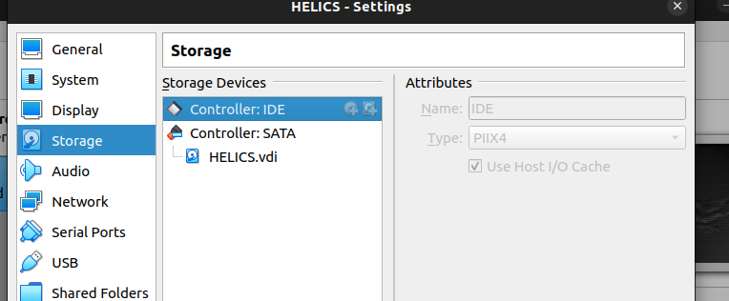
Work - Zach
Went through our planned attack vectors & starting planning each implementation:
Cold Boot Attack - use a “usb” of an ubuntu iso to get read-only/write-only access to the machines hard drive

Slide 6
Zach (Continued)
Primarily using MetaSploit framework for non-codeable attacks
https://docs.metasploit.com/
i.e.
SYN Flood

Slide 7
Zach (Continued)
Attacks that will have to be programmed:
Wireshark/Man in the Middle - Link
Rubber Ducky - A “usb” keyboard that emulates a usb keyboard plugged into the workstation
Solarwinds - Link
Spyware - credential stealer/spoof

Slide 8
Kaya’s Work
Attempted to connect pandapower and py_dss using helics.
Used the pandapower default example, imported the 4Bus-DY-Bal.DSS for py_dss
Edited the json config and runner files in Helics, got it to run, but failed with the DSS file.
Questions:
Difference between the 4Bus examples? Ex. 4Bus-GrdYD-Bal, 4Bus-DY-Bal, 4Bus-OYOD-Bal
The example folders in OpenDSS has many things besides just .DSS files, but Py_DSS only needs a .dss file, ignore the other files in the folders?
What input would the 4Bus-GrdYD-Bal or other pydss files need? It seems like it’s doing the entire thing itself.
Next steps: Working with Matt and Tommy more to create a pandapower and openDSS file that works together

Slide 9
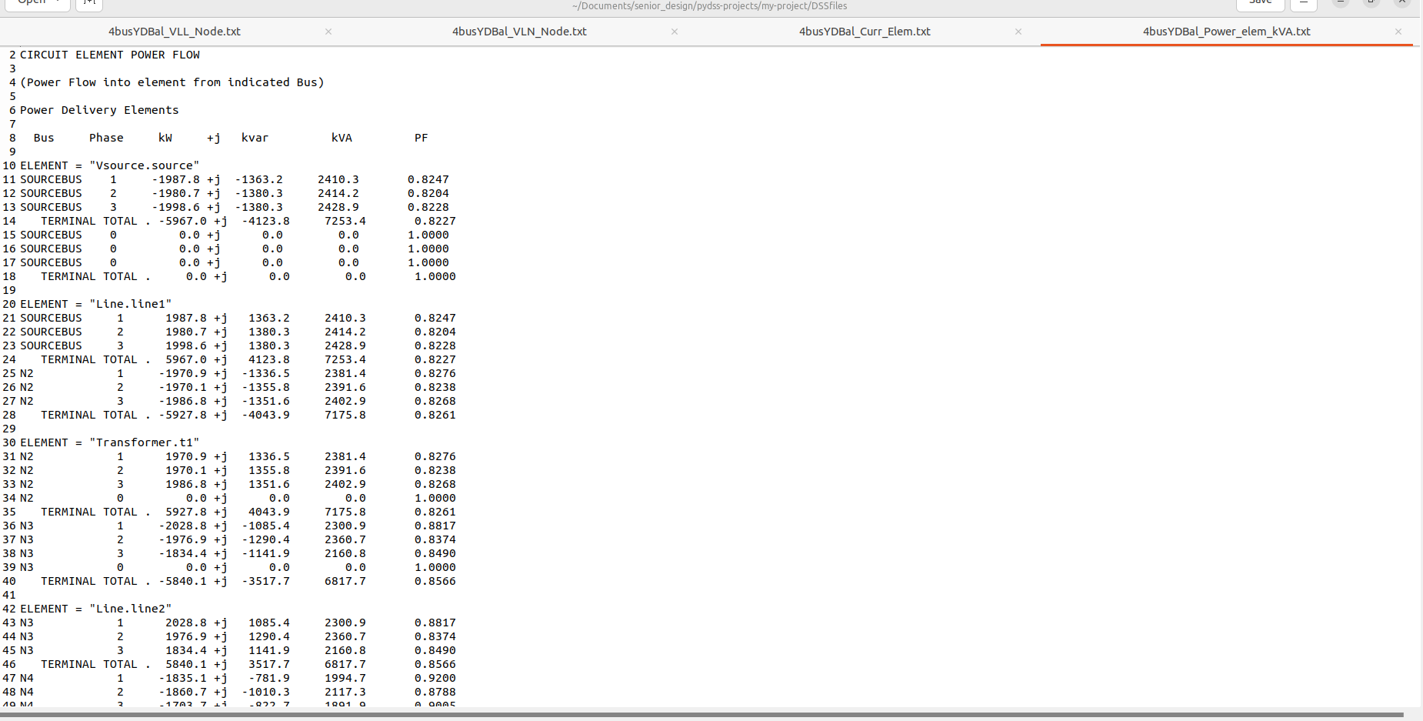
Kaya’s Work - Pandapower and PyDSS

Slide 10
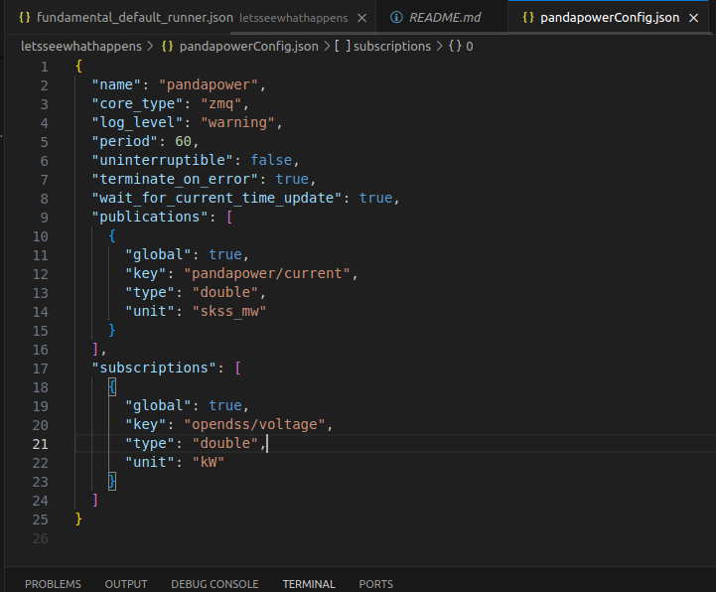
Kaya’s Work
Pandapower json
Set pub current type to skss_mw
Set sub type to kW

Slide 11
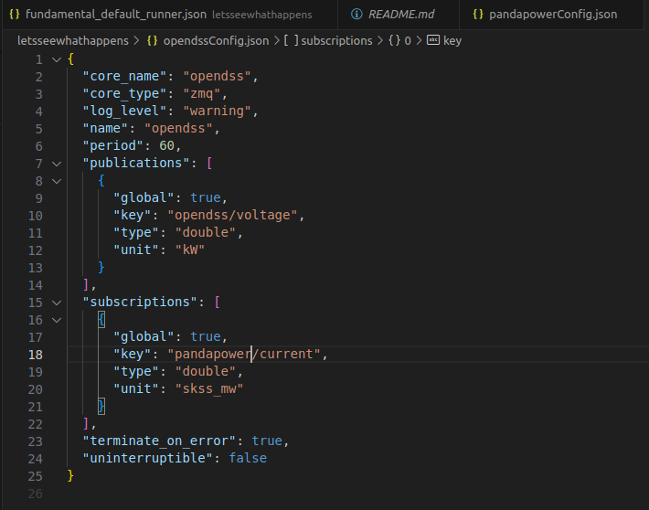
Kaya’s Work
Py/OpenDSS json
Set pub to kW
Set sub to skss_mw

Slide 12
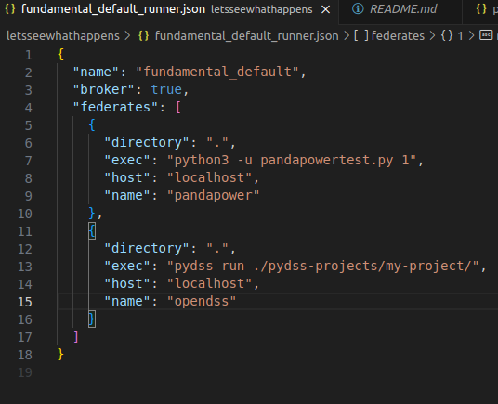
Kaya’s Work
Runner json
Edited names and exec

Slide 13
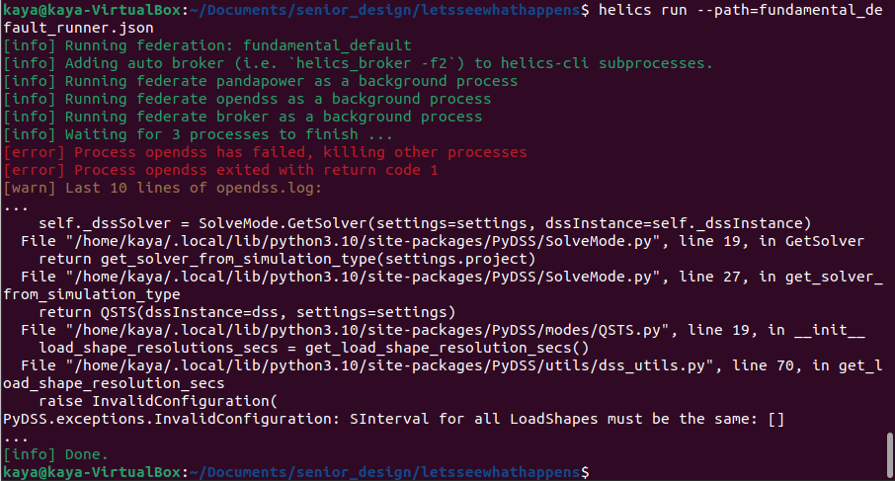
It at least ran

Slide 14
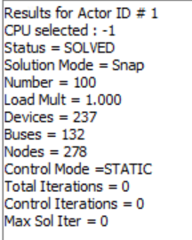
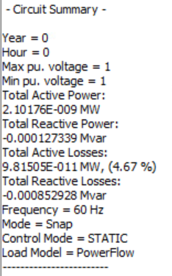
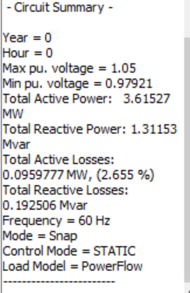
Work - Tommy & Matt
Import and run the 123Bus model in OpenDSS
Results for 123Bus case:

Slide 15
Work - Tommy & Matt
Creates the Y-bus matrix in order to solve power flow
Will not solve power flow without running these lines of code
Iterations:
Control iterations: it took 1 iteration to be within range
2 iterations inside of the first iteration

Slide 16
Work - Tommy & Matt
How to create new transformer instance:
_
3 phase, 150kVA power rating, 2 windings, delta-delta connection, %r (assumed to be resistance in p.u.) = 0.635, nominal low-side voltage = 480V, nominal high-side voltage = 4160V

Slide 17
OpenDSS Youtube Tutorials
OpenDSS Youtube Tutorials:
https://youtu.be/7ATNVI3Cghs?si=rXfSNiCz4XeQmovN
How to load different test cases and run using ctrl A then ctrl D to solve
https://youtu.be/xxXmV7H83U0?si=J8j92Eecfm9dCOmp
Running line codes individually and running instances for devices
https://youtu.be/eg48-J73gt8?si=7vPjhQ2WhMW89kJJ
How to show event log, and what iterations mean, changing the control mode
https://youtu.be/hBZbTzot3h4?si=TMfwNticj1c_UOq3

Slide 18
Justin’s Work
Worked on getting the Docker environment to boot on the given VMs
Installed some extra software asides from what Kaya installed.
Edited compose.yaml and Dockerfiles
Questions:
Why is Docker not running on the machines?
Is there any next steps to do in order to prepare the Docker instances for programs?
Is there any next steps to do in order to prepare the Docker instances for attacks?

Slide 19
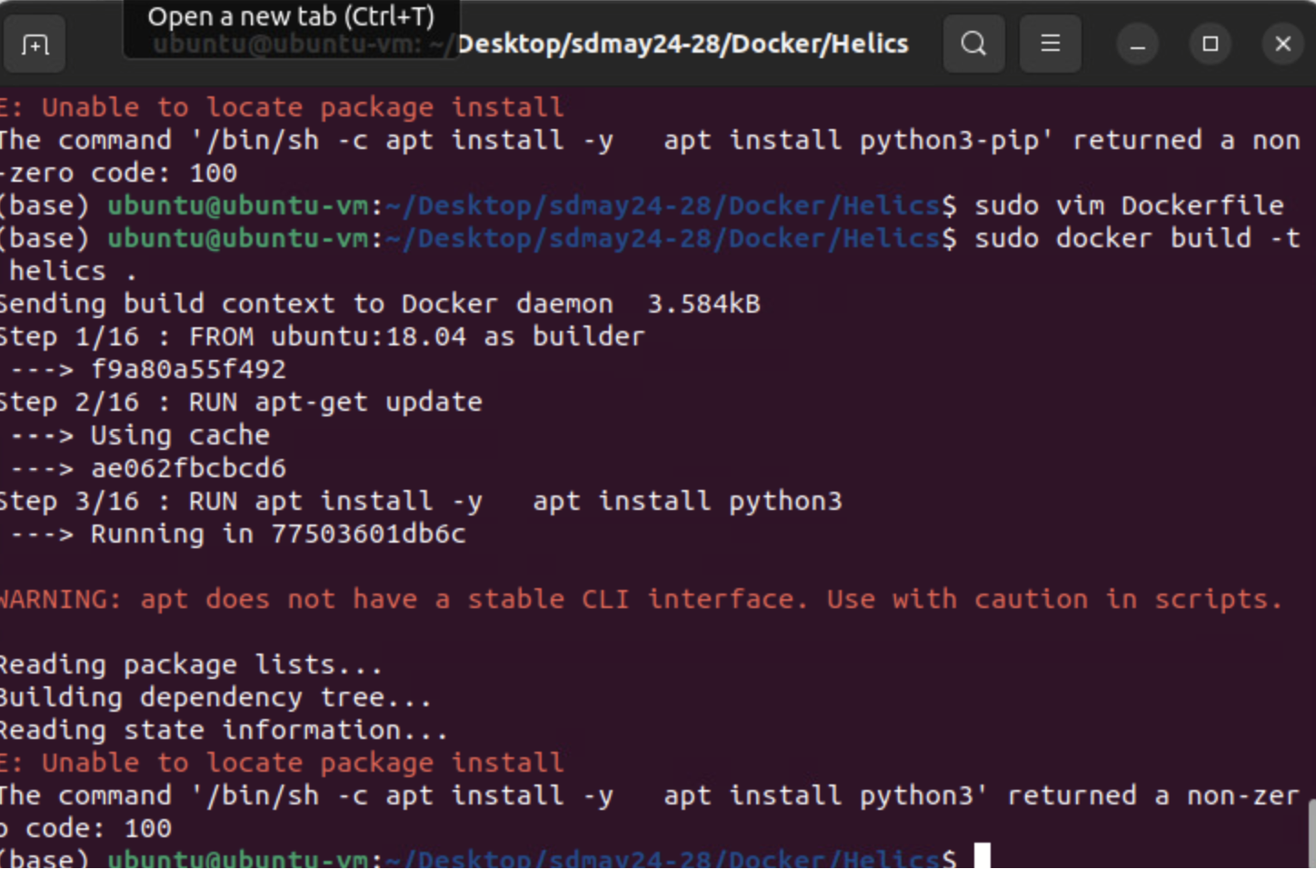
Justin’s Work

Slide 20
Next Week's Plan
Continue attempting to connect pandapower, py_dss, and helics
Start working on Testing lightning talk and document

